Slide 1
Graph

Slide 2
What is a Graph?
A graph G = (V,E) is composed of:
V: set of vertices or Nodes
E: set of edges connecting the vertices in V
An edge e = (u,v) is a pair of vertices
Example:
a
b
V= {a,b,c,d,e}
E= {(a,b),(a,c),(a,d),
(b,e),(c,d),(c,e),
(d,e)}
c
d
e

Slide 3
Applications
CS16
electronic circuits
networks (roads, flights, communications)
JFK
LAX
LAX
STL
HNL
DFW
FTL

Slide 4
Terminology:
Adjacent and Incident
If (v0, v1) is an edge in an undirected graph,
  v0 and v1 are adjacent
  The edge (v0, v1) is incident on vertices v0 and v1
If <v0, v1> is an edge in a directed graph
  v0 is adjacent to v1, and v1 is adjacent from v0
  The edge <v0, v1> is incident on v0 and v1

Slide 5

Terminology:
Degree of a Vertex
The degree of a vertex is the number of edges incident to that vertex
For directed graph,
  the in-degree of a vertex v is the number of edges
  that have v as the head
  the out-degree of a vertex v is the number of edges
  that have v as the tail

Slide 6
Examples:
0
3
0
2
1
2
3
1
2
3
3
3
3
4
5
6
3
G1
3
1
1
1
1
G2
0
directed graph
1
in: 1, out: 2
in-degree
out-degree
in:1, out: 1
2
in: 1, out: 0
G3

Slide 7
Terminology: Path
3
2
path: path p of length n from node u to node v is a sequence of n+1 nodes ( v₀, v₁, v₂, . . . . . , v_{n}) such that u = v₀ and v = v_{n} v_{i-1} is adjacent to v_{i} for I = 1 to n
3
3
3
a
b
a
b
c
c
d
e
d
e
a b e d c
b e d c

Slide 8
0
0
0
1
2
1
2
1
2
3
3
3
  The length of a path is the number of edges on it

Slide 9
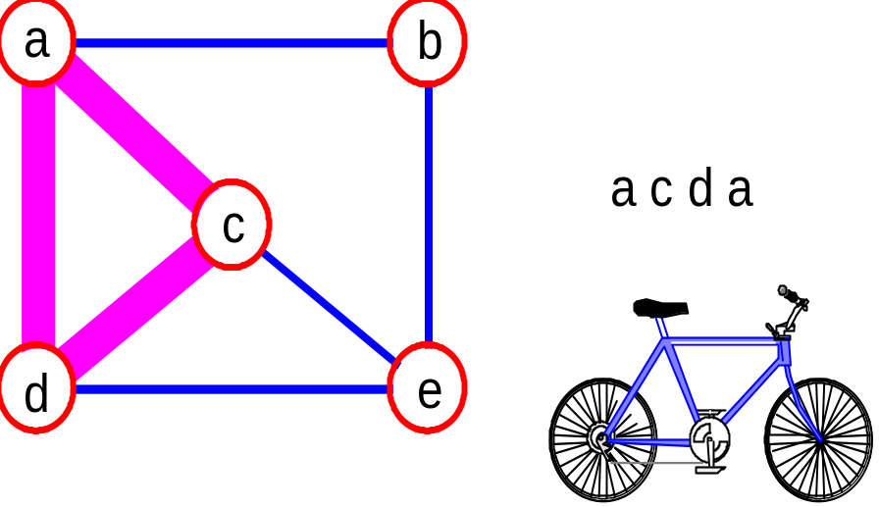
More Terminology
simple path:
  a path in which all vertices, except possibly the first and the last, are distinct.
  Cycle:
  A cycle is a simple path in which the first and the last vertices are the same.
a
b
b e c
c
d
e

Slide 10
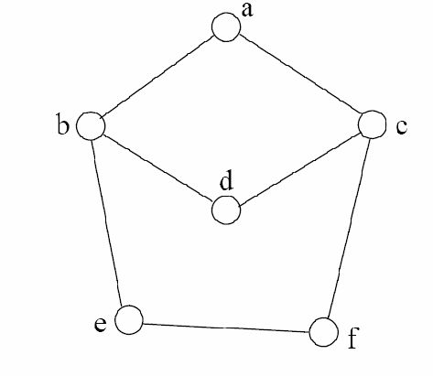
Path Examples
Are these paths?
Any cycles?
What is the path’s length?
{a,c,f,e}
{a,b,d,c,f,e}
{a, c, d, b, d, c, f, e}
{a, b, c, d}
{a,c,d,b,a}
{a,c,f,e,b,d,c,a}

Slide 11
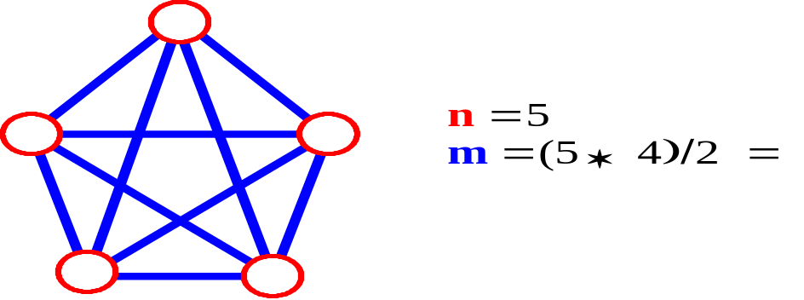
Connected Graph: A graph G is connected iff there is a simple path between any two nodes in G.
connected not connected
Note: tree is a connected graph without cycles
Complete Graph: A graph G is said to be complete if every node u in G is adjavent to every other node v in G. i.e. each node u is directly connected to all other nodes v in Graph G.
A complete graph with n nodes will have n(n-1)/2 edges.
Therefore, if a graph is not complete, m < n(n -1)/2

Slide 12
The definition of a graph may be generalized by permitting the following:
Multiple Edges: Distinct edges e and e’ are called multiple edges if they connect the same endpoints,
i.e. if e = [u, v] and e’ = [u, v].
Loops: An edge e is called a loop if it has identical endpoints ,
i.e. if e = [u, u] .
Note: Definition of a graph does not allow any loop or multiple edge in Graph.
A Graph with loops or multiple edges is called a Multi-graph.

Slide 13
undirected graph: An undirected graph is one in which the pair of vertices in a edge is unordered, (v0, v1) = (v1, v0)
directed graph: A directed graph is one in which each edge is a directed pair of vertices, (v0, v1) != (v1, v0)
Weighted Graph: Graph G is said to be weighted if each edge e is assigned a non-negative numerical value w(e) called the weight or length of edge.
If no other information about weights are given in a graph, then assume the weight w(e) = 1 for each edge.
tail
head

Slide 14
Directed-Graph
A Directed-graph G, also called Digraph or Graph, is same as the multigraph except that each edge e in G is assigned a direction i.e. each edge e is identified by an ordered pair (u, v ) of nodes in G, rather than an unorderd pair [u, v].
Teminology:
Edge e = (u, v) is called an Arc.
  e begins at u and ends at v.
  u is called origin and v is called destination.
  u is predecessor of v and v is sucessor of u.

Slide 15
Terminology relevance to directed graph :
Outdegree of node u : number of edges beginning at u
Indegree of node u : number of edges ending at u
Source node: +ve outdegree and 0 indegree
Sink : +ve indegree and 0 outdegree
A node v is reachable from node u if there is a directed path from u to v
Strongly connected directed graph : if for each pair u,v of vertices in G, if there exists a path from u to v, there must exist a path from v to u
Directed acyclic graph : A directed acyclic graph or DAG is a directed graph with no directed cycles:

Slide 16
Graph Representation
Two popular computer representations of a graph. Both represent the vertex set and the edge set, but in different ways.
  Adjacency Matrix
    Use a 2D matrix to represent the graph
  Adjacency List
    Use a 1D array of linked lists

Slide 17
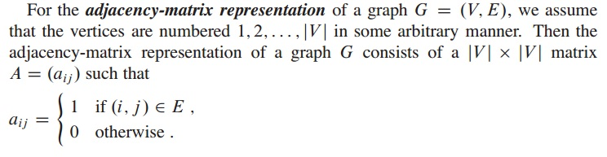
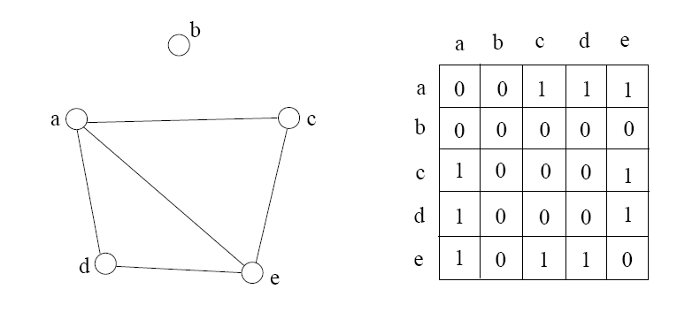
Adjacency Matrix

Slide 18
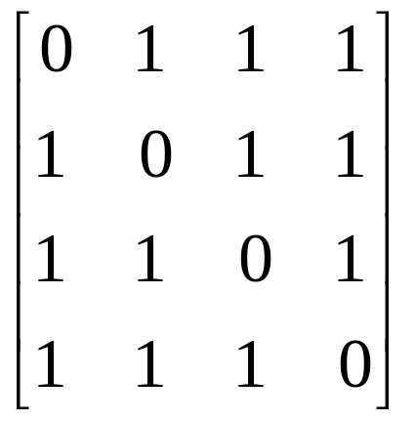
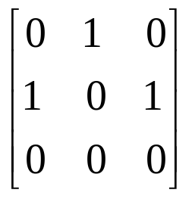
Examples for Adjacency Matrix
0
0
1
2
1
3
2
G1
G2

Slide 19
Adjacency List
In Linked list representation of a graph, two linked list a vertex list(node list) and a adjacency list(edge list) are maintained.
Representation of a node in vertex list:
Vert_INFO | NextLink | Adj_Link
Representation of a node in edge list:
Link_Vert | Link

Slide 20
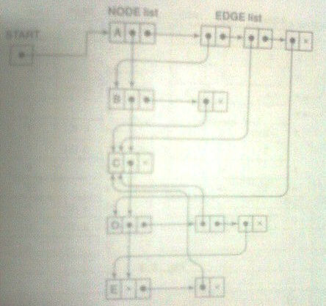
D
A
E
B
C
Node | Adjancency List
A | B, C, D
B | C
C
D | C, E
E | C

Slide 21
Linked representation(Adjacency List)
Each row in adjacency matrix is represented as an adjacency list.
0
0
1
2
1
3
0
1
2
3
1
2
3
2
0
2
3
0
1
2
1
0
1
3
0
2
0
1
2
G1
G2

Slide 22
Sequential Representation of Graphs : Adjacency Matrix and Path Matrix
Y
X
Z
W
0 | 0 | 0 | 1
1 | 0 | 1 | 1
1 | 0 | 0 | 1
0 | 0 | 1 | 0
Adjacency Matrix of Graph

Slide 23
Path Matrix
Let G be a simple directed graph with m nodes, v1, v2, v3,…..Vm. The Path Matrix or reachability matrix of G is the m-squre matrix P=(Pij) defined as follows:
1 if there is a path form vertex vi to vj
Pij =
0 otherwise

Slide 24
Sequential Representation of Graphs : Adjacency Matrix and Path Matrix
Y
X
Z
W
0 | 0 | 0 | 1
1 | 0 | 1 | 1
1 | 0 | 0 | 1
0 | 0 | 1 | 0
0 | 0 | 1 | 0
1 | 0 | 1 | 2
0 | 0 | 1 | 1
1 | 0 | 0 | 1
1 | 0 | 0 | 1
1 | 0 | 2 | 2
1 | 0 | 1 | 1
0 | 0 | 1 | 1
0 | 0 | 1 | 1
2 | 0 | 2 | 3
1 | 0 | 1 | 2
1 | 0 | 1 | 1
A₁ =
A₂ =
A₃ =
A₄ =
Number of Paths between Y to W of length 3 are 2
(Y -> Z -> X -> W AND Y->W->Z->W)
B₄ = A₁ + A₂ + A₃ + A₄

Slide 25
1 | 0 | 2 | 3
5 | 0 | 6 | 8
3 | 0 | 3 | 5
2 | 0 | 3 | 3
B₄ ₌
Now The path matrix P will be:
P=
1 | 0 | 1 | 1
1 | 0 | 1 | 1
1 | 0 | 1 | 1
1 | 0 | 1 | 1

Slide 26
Warshall's algorithm(Path Matrix)
Repeat for I, J = 1, 2,…, M: [Initializes P.]
  If A[I, J] = 0, then: Set P[I, J] := 0;
  Else Set P[I, J] := 1.
  [End of loop.]
Repeat Steps 3 and 4 for K = 1, 2,…, M: [Updates P.]
Repeat Step 4 for I = 1, 2,…, M:
Repeat J= 1, 2,…, M:
Set P[I, J] := P[I, J] OR (P[I, K] AND P[K, J])
  [End of loop.]
  [End of Step 3 loop.]
  [End of step 2 loop.]
Exit

Slide 27
Modified Warshall's algorithm Or Floyd Warshall Algorithm (Shortest-Path Algorithm)
Repeat for I, J = 1, 2,…, M: [Initializes P.]
  If W[I, J] = 0, then: Set Q[I, J] := Infinity;
  Else Set Q[I, J] := W[I,J].
  [End of loop.]
Repeat Steps 3 and 4 for K = 1, 2,…, M: [Updates P.]
Repeat Step 4 for I = 1, 2,…, M:
Repeat J= 1, 2,…, M:
Set Q[I, J] := MIN (Q[I, J], (Q[I, K] + Q[K, J]) )
  [End of loop.]
  [End of Step 3 loop.]
  [End of step 2 loop.]
Exit

Slide 28
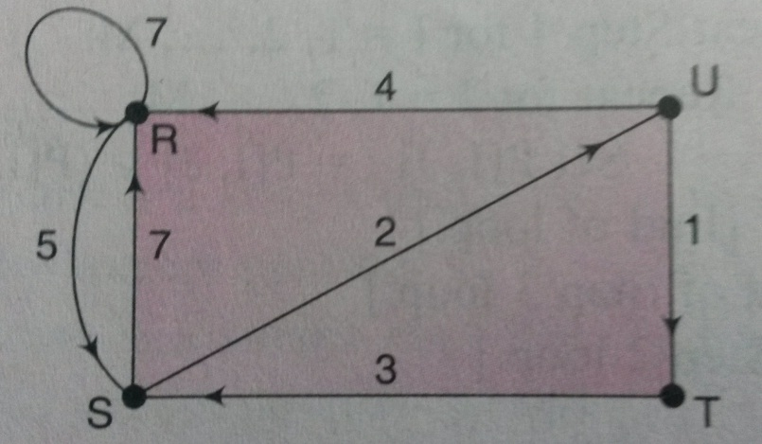

Slide 29
Assume v1=R, v2=s, v3=T and v4=U.
Weight matrix w=
7 | 5 | 0 | 0
7 | 0 | 0 | 2
0 | 3 | 0 | 0
4 | 0 | 1 | 0

Slide 30
Traversing a Graph
    Breadth First Search (BFS)
    Depth First Search (DFS)
  BFS will use Queue and DFS will use Stack as auxiliary storage
  The algorithm will process only those nodes which are reachable from the starting node
  During the execution of the algorithm, each node N of G will be in one of the three states, called status of N
    STATUS = 1 : Ready State , i.e. initial state of node N
    STATUS = 2 : Waiting State , i.e. node N is in Queue or stack waiting to be processed
    STATUS = 3 : Processed State , i.e. node N has been processed

Slide 31
Breadth-First Search:
Initialize all nodes to Ready State (STATUS = 1).
Put the statrting node A in Queue and change its status to Waiting State (STATUS = 2).
Repeat step 4 and 5 until Queue is empty:
Remove the front node N of the Queue. Process N and set the status of N to STATUS=3.
Add to the Rear of Queue all the neighbors of N that are in STATUS = 1. and change their status to STATUS = 2.
[End of step 3 Loop.]
Exit.

Slide 32
Breadth -First Search
Queue: A
A
B
E
G
C
D
F
Start with A. Mark it.

Slide 33
Breadth -First Search
Queue: A B E
A
B
E
G
C
D
F
Now take A off queue, Expand A’s adjacent vertices.
Mark them and put them in queue.

Slide 34
Breadth -First Search
Queue: A B E C G
A
B
E
G
C
D
F
Now take B off queue, and queue its neighbors.

Slide 35
Breadth -First Search
Queue: A B E C G D F
A
B
E
G
C
D
F
Do same with E.

Slide 36
Breadth -First Search
Queue: A B E C G D F
A
B
E
G
C
D
F
Visit C.
Its neighbor F is already marked, so not queued.

Slide 37
Breadth -First Search
Queue: A B E C G D F
A
B
E
G
C
D
F
Visit G.

Slide 38
Breadth -First Search
Queue: A B E C G D F
A
B
E
G
C
D
F
Visit D. F, E marked so not queued.

Slide 39
Breadth -First Search
Queue: A B E C G D F
A
B
E
G
C
D
F
Visit F.
E, D, C marked, so not queued again.

Slide 40
Breadth -First Search
Queue: A B E C G D F
A
B
E
G
C
D
F
Done. We have explored the graph in order:
A B E C G D F.

Slide 41
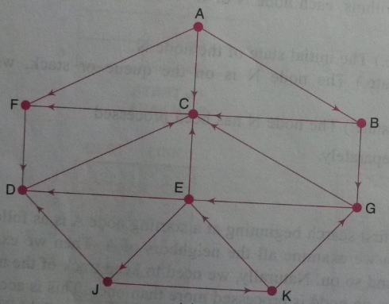
Consider the graph G as shown below. Suppose G represent daily flights between cities of some airline, and suppose we want to fly from city A to city J with minimum number of stops. In other words, we want the minimum path p from A to J(where each edge has length 1).

Slide 42
Node | Adj List
A | F, C , B
B | G, C
C | F
D | C
E | D, C, J
F | D
G | C, E
J | D, K
K | E, G
STEP | QUEUE | ORIGIN | F | R
1 | A | 0 | 1 | 1
2 | AFCB | 0AAA | 2 | 4
3 | AFCBD | 0AAAF | 3 | 5
4 | AFCBD | 0AAAF | 4 | 5
5 | AFCBDG | 0AAAFB | 5 | 6
6 | AFCBDG | 0AAAFB | 6 | 6
7 | AFCBDGE | 0AAAFBG | 7 | 7
8 | AFCBDGEJ | 0AAAFBGJ | 8 | 8
9 | … | … | .. | ..
10 | … | …. | .. | ..

Slide 43
Depth-First Search:
Initialize all nodes to Ready State (STATUS = 1).
Push the statrting node A onto STACK and change its status to Waiting State (STATUS = 2).
Repeat step 4 and 5 until STACK is empty:
POP the TOP node N from the STACK. Process N and set the status of N to STATUS=3.
PUSH onto STACK all the neighbors of N that are in STATUS = 1, and change their status to STATUS = 2.
[End of step 3 Loop.]
Exit.

Slide 44
Depth-First Search
Current vertex: A
A
B
E
G
C
D
F
Start with A. Mark it.

Slide 45
Depth-First Search
Current vertex: B
A
B
E
G
C
D
F
Expand A’s adjacent vertices. Pick one (B).
Mark it and re-visit.

Slide 46
Depth-First Search
Current vertex: C
A
B
E
G
C
D
F
Now expand B, and visit its neighbor, C.

Slide 47
Depth-First Search
Current vertex: F
A
B
E
G
C
D
F
Visit F.
Pick one of its neighbors, E.

Slide 48
Depth-First Search
Current vertex: E
A
B
E
G
C
D
F
E’s adjacent vertices are A, D and F.
A and F are marked, so pick D.

Slide 49
Depth-First Search
Current vertex: D
A
B
E
G
C
D
F
Visit D. No new vertices available. Backtrack to
E. Backtrack to F. Backtrack to C. Backtrack to B

Slide 50
Depth-First Search
Current vertex: G
A
B
E
G
C
D
F
Visit G. No new vertices from here. Backtrack to
B. Backtrack to A. E already marked so no new.

Slide 51
Depth-First Search
Current vertex:
1
A
2
5
B
E
6
3
7
C
D
G
4
F
Done. We have explored the graph in order:
A B C F E D G

Slide 53
Node | Adj List
A | F, C , B
B | G, C
C | F
D | C
E | D, C, J
F | D
G | C, E
J | D, K
K | E, G
STEP | STACK | POP
1 | A | A
2 | FCB | AB
3 | FCG | ABG
4 | FCE | ABGE
5 | FCDJ | ABGEJ
6 | … | …

